Slide 1
OpenACC Course
Lecture 4: Advanced OpenACC Techniques
November 12, 2015

Slide 2
Lecture Objective: Demonstrate OpenACC pipelining, Interoperating with Libraries, and Use with MPI.

Slide 3
Oct 1: Introduction to OpenACC
Oct 6: Office Hours
Oct 15: Profiling and Parallelizing with the OpenACC Toolkit
Oct 20: Office Hours
Oct 29: Expressing Data Locality and Optimizations with OpenACC
Nov 3: Office Hours
Nov 12: Advanced OpenACC Techniques
Nov 24: Office Hours
Course Syllabus
Recordings: https://developer.nvidia.com/openacc-course

Slide 4
Advanced OpenACC Techniques: Pipelining, MPI and Interoperability
Jiri Kraus, NVIDIA Developer Technologies

Slide 5
Part 1: Asynchronous Programming with OpenACC
Part 2: Multi GPU Programming with MPI and OpenACC
Agenda

Slide 6
Asynchronous Programming with OpenACC

Slide 7
Asynchronous Programming
Programming such that two or more unrelated operations can occur independently or even at the same time without immediate synchronization.
Real World Examples:
Cooking a Meal: Boiling potatoes while preparing other parts of the dish.
Three students working on a project on George Washington, one researches his early life, another his military career, and the third his presidency.
Automobile assembly line: each station adds a different part to the car until it is finally assembled.

Slide 8
Asynchronous Example 1
I want to populate two arrays, A and B, with data, then add them together. This requires 3 distinct operations.
Populate A
Populate B
Add A + B
Tasks 1 and 2 are independent, but task 3 is dependent on both.

Slide 9
Asynchronous Example 1 cont.
Synchronous Execution
Asynchronous Execution
Populate A
Populate A
Populate B
Populate B
Calculate A + B
Note: Nothing here guarantees that A & B will be populated at the same time, but by making them asynchronous, it’s now possible to run them in parallel.
Calculate A + B

Slide 10

Asynchronous Pipelining
Very large operations may frequently be broken into smaller parts that may be performed independently.
Pipeline Stage -A single step, which is frequently limited to 1 part at a time
Photo by Roger Wollstadt, used via Creative Commons

Slide 11

Case Study: Mandelbrot Set
Application generates the image to the right.
Each pixel in the image can be independently calculated.
Skills Used:
Parallel Loop or Kernels Directive
Data Region
Update Directive
Asynchronous Pipelining

Slide 12
Mandelbrot code
// Calculate value for a pixel
unsigned char mandelbrot(int Px, int Py) {
double x0=xmin+Px*dx; double y0=ymin+Py*dy;
double x=0.0; double y=0.0;
for(int i=0;x*x+y*y<4.0 && i<MAX_ITERS;i++) {
double xtemp=x*x-y*y+x0;
y=2*x*y+y0;
x=xtemp;
}
return (double)MAX_COLOR*i/MAX_ITERS;
}
// Used in main()
for(int y=0;y<HEIGHT;y++) {
for(int x=0;x<WIDTH;x++) {
image[y*WIDTH+x]=mandelbrot(x,y);
}
}
The mandelbrot() function calculates the color for each pixel.
Within main() there is a doubly-nested loop that calculates each pixel independently.

Slide 13
OpenACC Routine Directive
Specifies that the compiler should generate a device copy of the function/subroutine and what type of parallelism the routine contains.
Clauses:
gang/worker/vector/seq
Specifies the level of parallelism contained in the routine.
bind
Specifies an optional name for the routine, also supplied at call-site
no_host
The routine will only be used on the device
device_type
Specialize this routine for a particular device type.

Slide 14
Routine Directive: C/C++
// foo.h
#pragma acc routine seq
double foo(int i);
// Used in main()
#pragma acc parallel loop
for(int i=0;i<N;i++) {
array[i] = foo(i);
}
At function source:
Function needs to be built for the GPU.
It will be called by each thread (sequentially)
At call the compiler needs to know:
Function will be available on the GPU
It is a sequential routine

Slide 15
OpenACC Routine: Fortran
module foo_mod
contains
real(8) function foo(i)
implicit none
!$acc routine(foo) seq
integer, intent(in), value :: i
...
end function foo
end module foo_mod
The routine directive may appear in a Fortran function or subroutine definition, or in an interface block.
The save attribute is not supported.
Nested acc routines require the routine directive within each nested routine.

Slide 16
Step 1 code
The mandelbrot() function must be declared a sequential routine.
// In mandelbrot.h
#pragma acc routine seq
unsigned char mandelbrot(int Px, int Py);
// Used in main()
#pragma acc parallel loop
for(int y=0;y<HEIGHT;y++) {
for(int x=0;x<WIDTH;x++) {
image[y*WIDTH+x]=mandelbrot(x,y);
}
}
The main loops are parallelizes with parallel loop or kernels.

Slide 17
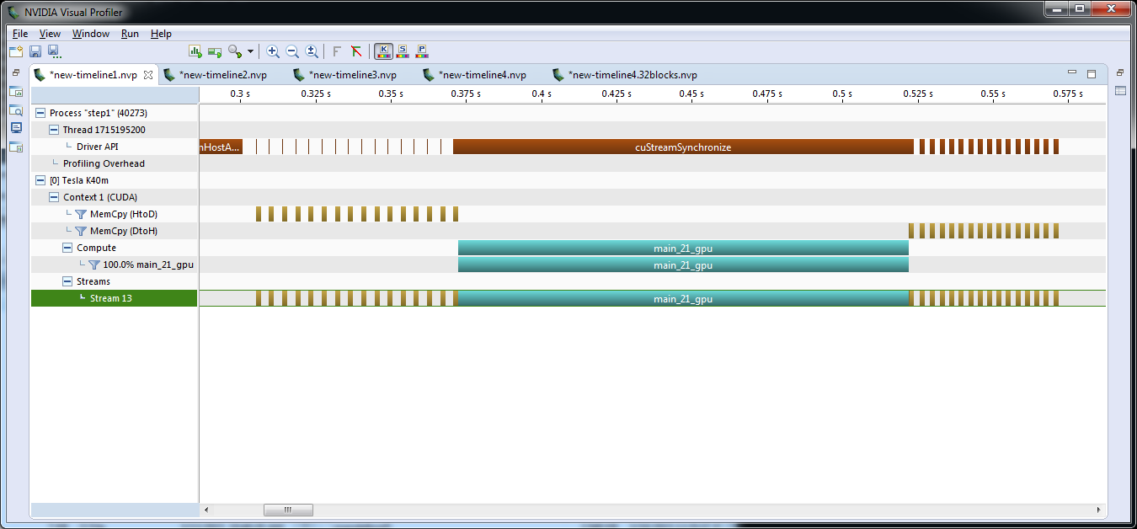
Step 1 Profile

Slide 18
Step 1 Profile
Half of our time is copying, none of it is overlapped.
PCIe Transfers
PCIe Transfers
We’re still much faster than the CPU because there’s a lot of work.

Slide 19
Pipelining Data Transfers
H2D
kernel
D2H
H2D
kernel
D2H
Two Independent Operations Serialized
NOTE: In real applications, your boxes will not be so evenly sized.
H2D
kernel
D2H
H2D
kernel
D2H
Overlapping Copying and Computation

Slide 20
Pipelining Mandelbrot set
We only have 1 kernel, so there’s nothing to overlap.
Since each pixel is independent, computation can be broken up
Steps
Break up computation into blocks along rows.
Break up copies according to blocks
Make both computation and copies asynchronous

Slide 21
Pipelining Mandelbrot set
We only have 1 kernel, so there’s nothing to overlap.
Since each pixel is independent, computation can be broken up
Steps
Break up computation into blocks along rows.
Break up copies according to blocks
Make both computation and copies asynchronous
block 0
block 1
block 2
block 3

Slide 22
Step 2: Blocking Computation
Add a loop over blocks
Modify the existing row loop to only work within blocks
Add data region around blocking loop to leave data local to the device.
Check for correct results.
24 numblocks = ( argc > 1 ) ? atoi(argv[1]) : 8;
25 blocksize = HEIGHT / numblocks;
26 printf("numblocks: %d, blocksize: %d\n",
numblocks, blocksize);
27
28 #pragma acc data copyout(image[:bytes])
29 for(int block=0; block < numblocks; block++)
30 {
31 int ystart = block * blocksize;
32 int yend = ystart + blocksize;
33 #pragma acc parallel loop
34 for(int y=ystart;y<yend;y++) {
35 for(int x=0;x<WIDTH;x++) {
36 image[y*WIDTH+x]=mandelbrot(x,y);
37 }
38 }
39 }
NOTE: We don’t need to copy in the array, so make it an explicit copyout.

Slide 23
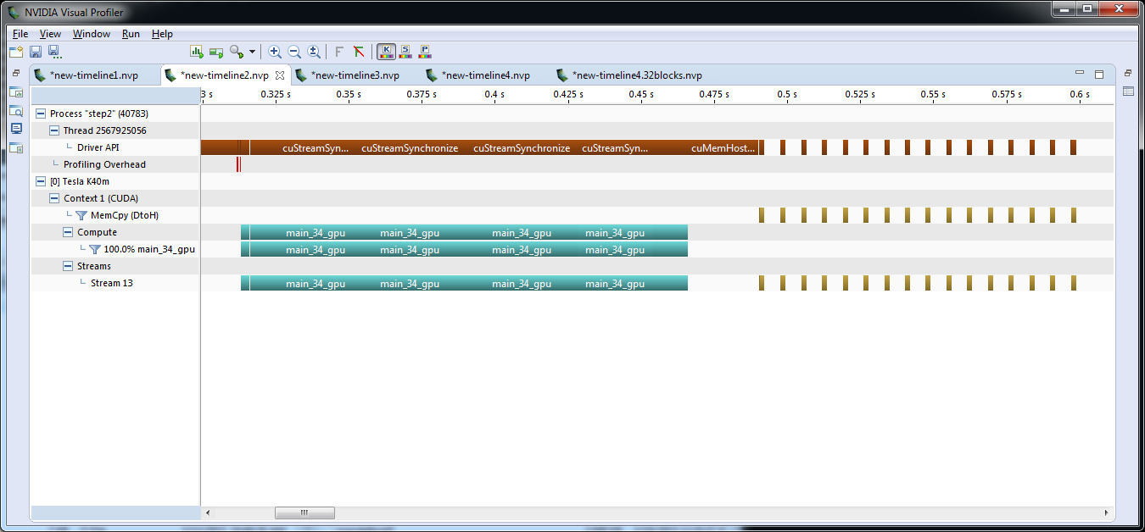
Blocking Timeline
Now we have 8 kernel launches and no longer copy data to the device, but the execution time has remained roughly the same.

Slide 24
OpenACC Update Directive
Programmer specifies an array (or part of an array) that should be refreshed within a data region.
!$acc data create(a)
do_something_on_device()
!$acc update self(a)
do_something_on_host()
!$acc update device(a)
!$acc end data
Copy “a” from GPU to CPU
Copy “a” from CPU to GPU

Slide 25
Step 3: Copy By Block
28 #pragma acc data create(image[:bytes])
29 for(int block=0; block < numblocks;
block++)
30 {
31 int ystart = block * blocksize;
32 int yend = ystart + blocksize;
33 #pragma acc parallel loop
34 for(int y=ystart;y<yend;y++) {
35 for(int x=0;x<WIDTH;x++) {
36 image[y*WIDTH+x]=mandelbrot(x,y);
37 }
38 }
39 #pragma acc update
self(image[ystart*WIDTH:WIDTH*blocksize])
40 }
Change the data region to only create the array on the GPU
Use an update directive to copy individual blocks back to the host when complete
Check for correct results.

Slide 26
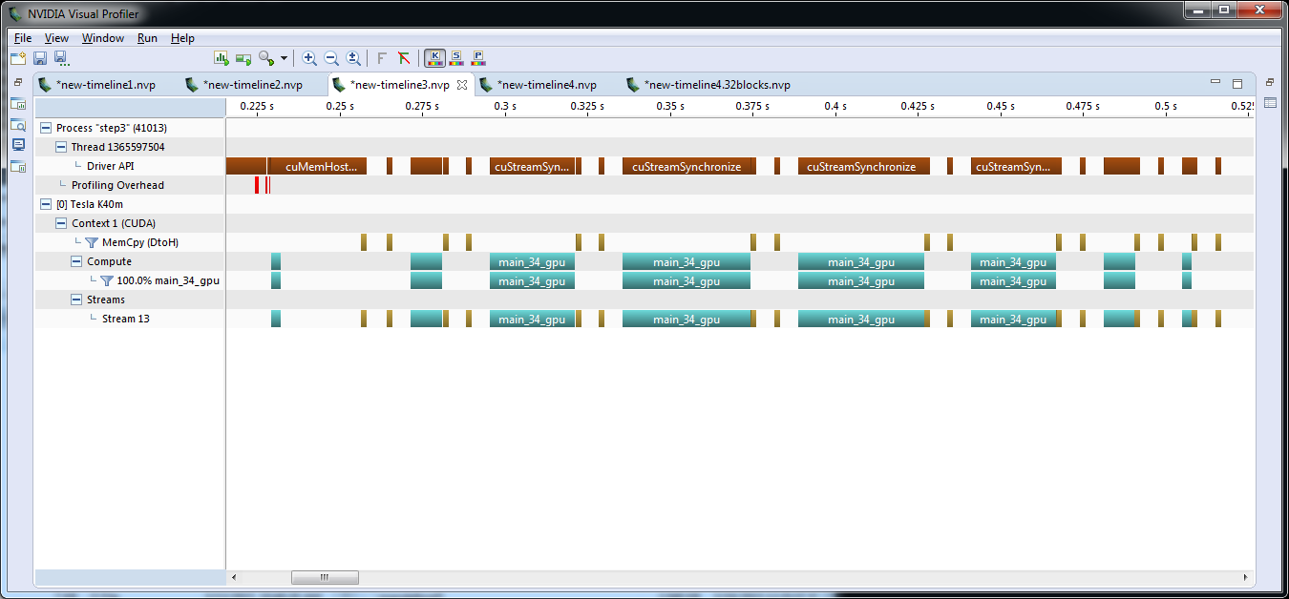
Timeline: Updating by Blocks
We’re now updating between blocks, but not overlapping.

Slide 27
OpenACC async and wait
async(n): launches work asynchronously in queue n
wait(n): blocks host until all operations in queue n have completed
Can significantly reduce launch latency, enables pipelining and concurrent operations
#pragma acc parallel loop async(1)
...
#pragma acc parallel loop async(1)
for(int i=0; i<N; i++)
...
#pragma acc wait(1)
for(int i=0; i<N; i++)
If n is not specified, async will go into a default queue and wait will wait all previously queued work.

Slide 28
Step 4: Go Asynchronous
31 #pragma acc data create(image[:bytes])
32 for(int block=0; block < numblocks; block++)
33 {
34 int ystart = block * blocksize;
35 int yend = ystart + blocksize;
36 #pragma acc parallel loop async(block%2)
37 for(int y=ystart;y<yend;y++) {
38 for(int x=0;x<WIDTH;x++) {
39 image[y*WIDTH+x]=mandelbrot(x,y);
40 }
41 }
42 #pragma acc update
self(image[ystart*WIDTH:WIDTH*blocksize])
async(block%2)
43 }
44 #pragma acc wait
Make each parallel region asynchronous by placing in different queues.
Make each update asynchronous by placing in same stream as the parallel region on which it depends
Synchronize for all to complete.
Check for correct results.

Slide 29
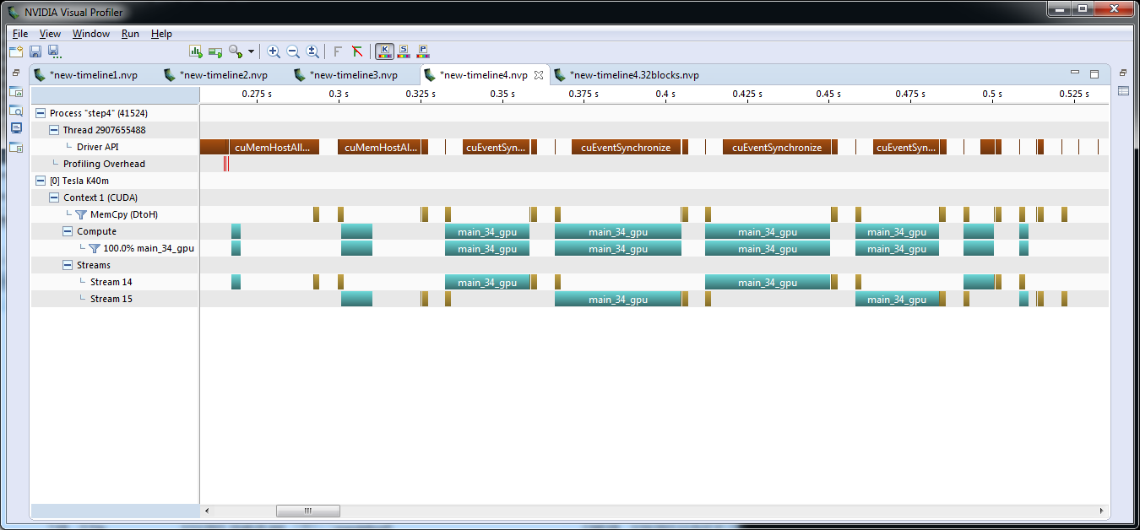
Timeline: Pipelining
Notice the kernel launches seem to take differing amounts of time. What if we tried smaller blocks?
Homework

Slide 30
Mandelbrot
Homework
The Homework for this case study is available in the “Pipelining Work on the GPU with OpenACC“ lab at https://nvidia.qwiklab.com/ and consists of 4 steps
Use OpenACC routine and parallel loop or kernels directive to make generate the image on the GPU.
Break the image creation into blocks by adding a blocking loop around the existing loops and changing the “y” loop to operate on blocks.
Change the data region to create the image array and use the update directive to copy each block back upon completion.
Use the block numbers to place blocks in multiple async queues and wait for all queues to complete. Experiment with the number of blocks and queues.

Slide 31
Multi-GPU Programming

Slide 32
Multi-GPU OpenACC (Single-threaded)
for (int gpu=0; gpu < 2 ; gpu ++)
{
acc_set_device_num(gpu,acc_device_nvidia);
#pragma acc enter data create(image[:bytes])
}
for(int block=0; block < numblocks; block++)
{
int ystart = block * blocksize;
int yend = ystart + blocksize;
acc_set_device_num(block%2,acc_device_nvidia);
#pragma acc parallel loop async(block%2)
for(int y=ystart;y<yend;y++) {
for(int x=0;x<WIDTH;x++) {
image[y*WIDTH+x]=mandelbrot(x,y);
}
}
#pragma acc update self(image[ystart*WIDTH:WIDTH*blocksize]) async(block%2)
}
for (int gpu=0; gpu < 2 ; gpu ++)
{
acc_set_device_num(gpu,acc_device_nvidia);
#pragma acc wait
#pragma acc exit data delete(image)
}
Allocate space on each device
Alternate devices per block
Clean up the devices

Slide 33
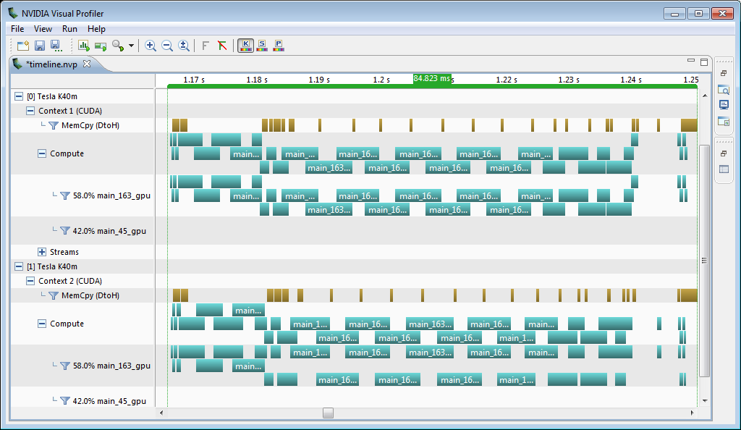
Multi-GPU Mandelbrot Profile

Slide 34
Multi-GPU OpenACC with OpenMP
#pragma omp parallel
{
int my_gpu = omp_get_thread_num();
acc_set_device_num(my_gpu,acc_device_nvidia);
#pragma acc data create(image[0:HEIGHT*WIDTH])
{
int queue = 1;
#pragma omp for schedule(static,1) firstprivate(queue)
for(int block=0; block < numblocks; block++)
{
int ystart = block * blocksize;
int yend = ystart + blocksize;
#pragma acc parallel loop async(queue)
for(int y=ystart;y<yend;y++) {
for(int x=0;x<WIDTH;x++) {
image[y*WIDTH+x]=mandelbrot(x,y);
}
}
#pragma acc update self(image[ystart*WIDTH:WIDTH*blocksize]) async(queue)
queue = queue%2+1;
}
#pragma acc wait
}
}
One OpenMP thread per device
Use multiple queues per device to get copy compute overlap
Wait for all work to complete

Slide 35
Multi GPU Programming with MPI and OpenACC

Slide 36
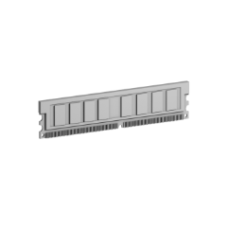



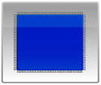
MPI+OpenACC
System
Memory
System
Memory
System
Memory
GDDR5
Memory
GDDR5
Memory
GDDR5
Memory
…
GPU
CPU
GPU
CPU
GPU
CPU
PCI-e
PCI-e
PCI-e
Network
Card
Network
Card
Network
Card
Node 0
Node 1
Node n-1
Notes:
So what is CUDA-aware MPI about. If we look at a cluster with n GPU equipped Nodes like the one shown here and a application that is accelerated with CUDA running on n nodes of this cluster. During execution the processes running on the different nodes need to exchanged data to collaborate. Buffers residing in system memory or buffers residing in GPU memory are used to exchange that data.

Slide 37
MPI+OpenACC
System
Memory
System
Memory
System
Memory
GDDR5
Memory
GDDR5
Memory
GDDR5
Memory
…
GPU
CPU
GPU
CPU
GPU
CPU
PCI-e
PCI-e
PCI-e
Network
Card
Network
Card
Network
Card
Node 0
Node 1
Node n-1
Notes:
So what is CUDA-aware MPI about. If we look at a cluster with n GPU equipped Nodes like the one shown here and a application that is accelerated with CUDA running on n nodes of this cluster. During execution the processes running on the different nodes need to exchanged data to collaborate. Buffers residing in system memory or buffers residing in GPU memory are used to exchange that data.

Slide 38
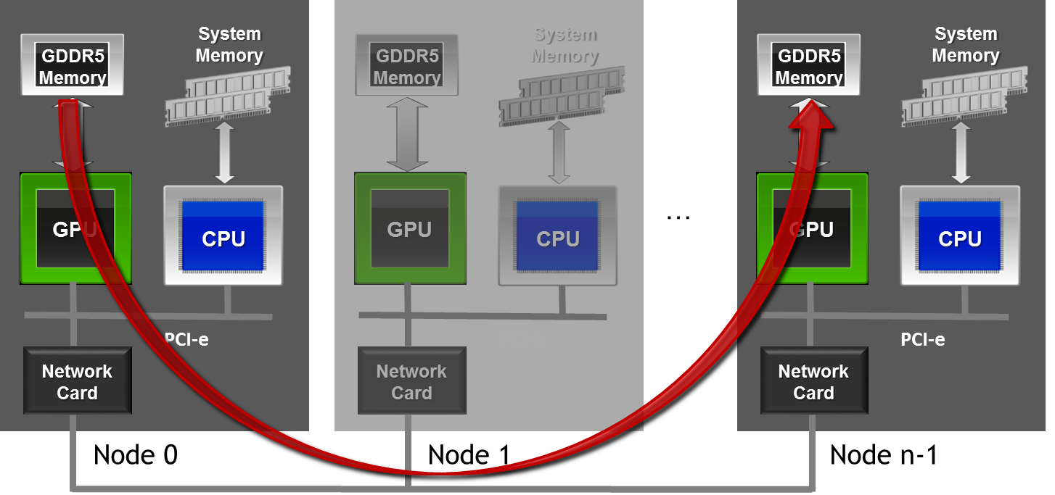
MPI+OpenACC
//MPI rank 0
MPI_Send(s_buf,size,MPI_CHAR,n-1,tag,MPI_COMM_WORLD);
//MPI rank n-1
MPI_Recv(r_buf,size,MPI_CHAR,0,tag,MPI_COMM_WORLD,&stat);
Notes:
With CUDA-aware MPI one can simply pass the involved buffers to the corresponding MPI calls so that the MPI implementation can take care of moving the data between source and destination.

Slide 39
Message Passing Interface - MPI
Standard to exchange data between processes via messages
Defines API to exchanges messages
Pt. 2 Pt.: e.g. MPI_Send, MPI_Recv
Collectives, e.g. MPI_Reduce
Multiple implementations (open source and commercial)
Bindings for C/C++, Fortran, Python, …
E.g. MPICH, OpenMPI, MVAPICH, IBM Platform MPI, Cray MPT, …
Notes:
MPI or Message Passing Interface is a standard to exchange data between processes via messages. The standard defines an application programming interface for this. The current version MPI-2 contains over 250 calls to cover a wide range of usage scenarios. Among these are calls to handle point to point communication like MPI_Send and MPI_Recv, which we will use as examples during this talk, as well as collective operations for reductions and broadcasts. Most MPI programs only require a very small subset of the available calls so there is no need to learn them all to get started with MPI. There are multiple implementations, both open source and commercial, of the MPI standard available.

Slide 40
MPI – A Minimal Program
#include <mpi.h>
int main(int argc, char *argv[]) {
int rank,size;
/* Initialize the MPI library */
MPI_Init(&argc,&argv);
/* Determine the calling process rank and total number of ranks */
MPI_Comm_size(MPI_COMM_WORLD,&size);
MPI_Comm_rank(MPI_COMM_WORLD,&rank);
/* Call MPI routines like MPI_Send, MPI_Recv, ... */
...
/* Shutdown MPI library */
MPI_Finalize();
return 0;
}
Notes:
The application that was just launched needs to first need to initialize the MPI library with a call to MPI_Init before I can make any other MPI calls. After MPI_Init all MPI calls can be called one very important is MPI_Comm_rank which queries the MPI library to assign a uniqe ID to each process participating in this MPI program. These IDs are usually named rank and are consecutive integers starting with 0. So for the application launch from the last slide myrank would be 0,1,2 and 3 for the four participating processes. The MPI ranks are needed as arguments to MPI calls that exchange message, e.g. in MPI_Send to specify where data should be send and in MPI_Recv to specify that we are expecting a message from the given rank. It is important to mention that mostly data is exchanged with so called two sided communication, i.e. for each MPI_Send there must be a corresponding MPI_Recv. So for every send message there must be a matching receiver. After the program has finished his work the resources obtained from the MPI library need to be freed by calling MPI_Finalize.
This was my very short introduction to MPI you do not need to know more about MPI to follow the remainder of this talk. The important think you need to remember is that a MPI program are n incarnations of the same binary with separate address spaces that can be identified by their MPI rank. Next I will explain the NVIDIA technologies UVA and GPUDirect.

Slide 41
MPI – A Minimal Program
#include <mpi.h>
int main(int argc, char *argv[]) {
int rank,size;
/* Initialize the MPI library */
MPI_Init(&argc,&argv);
/* Determine the calling process rank and total number of ranks */
MPI_Comm_size(MPI_COMM_WORLD,&size);
MPI_Comm_rank(MPI_COMM_WORLD,&rank);
/* Call MPI routines like MPI_Send, MPI_Recv, ... */
...
/* Shutdown MPI library */
MPI_Finalize();
return 0;
}
Remark: Almost all MPI routines return an error value which should be check. The examples and tasks leave that out for brevity.
Notes:
The application that was just launched needs to first need to initialize the MPI library with a call to MPI_Init before I can make any other MPI calls. After MPI_Init all MPI calls can be called one very important is MPI_Comm_rank which queries the MPI library to assign a uniqe ID to each process participating in this MPI program. These IDs are usually named rank and are consecutive integers starting with 0. So for the application launch from the last slide myrank would be 0,1,2 and 3 for the four participating processes. The MPI ranks are needed as arguments to MPI calls that exchange message, e.g. in MPI_Send to specify where data should be send and in MPI_Recv to specify that we are expecting a message from the given rank. It is important to mention that mostly data is exchanged with so called two sided communication, i.e. for each MPI_Send there must be a corresponding MPI_Recv. So for every send message there must be a matching receiver. After the program has finished his work the resources obtained from the MPI library need to be freed by calling MPI_Finalize.
This was my very short introduction to MPI you do not need to know more about MPI to follow the remainder of this talk. The important think you need to remember is that a MPI program are n incarnations of the same binary with separate address spaces that can be identified by their MPI rank. Next I will explain the NVIDIA technologies UVA and GPUDirect.

Slide 42
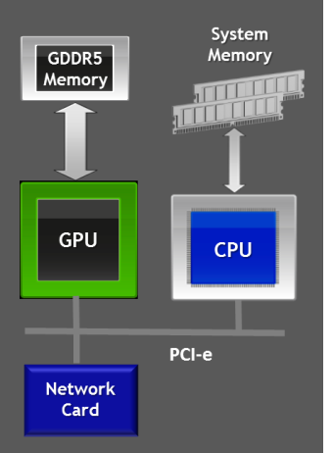
MPI – Compiling and Launching
$ mpicc –o myapp myapp.c
$ mpirun –np 4 ./myapp <args>
myapp
myapp
myapp
myapp
Notes:
Before I will show you an example of a MPI program written in C let me explain to you how MPI programs are started. An MPI implementation comes with a so called launcher which is usually named mpirun or mpiexec. This launcher knows about your cluster and can start multiple instances of you application on multiple notes. E.g. it can launch 4 incarnations of your application on 4 nodes on your cluster as shown here. These incarnations are processes with separate address spaces so it is possible to run one or more of these on a single node.

Slide 43
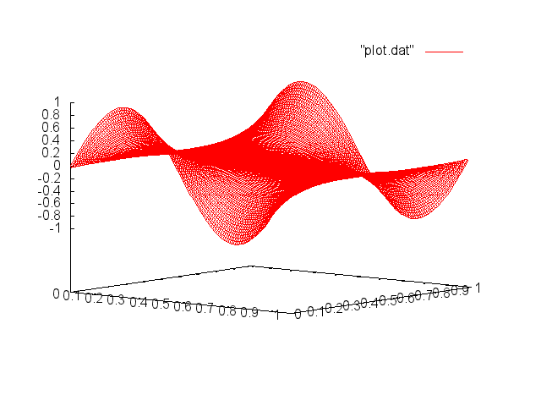
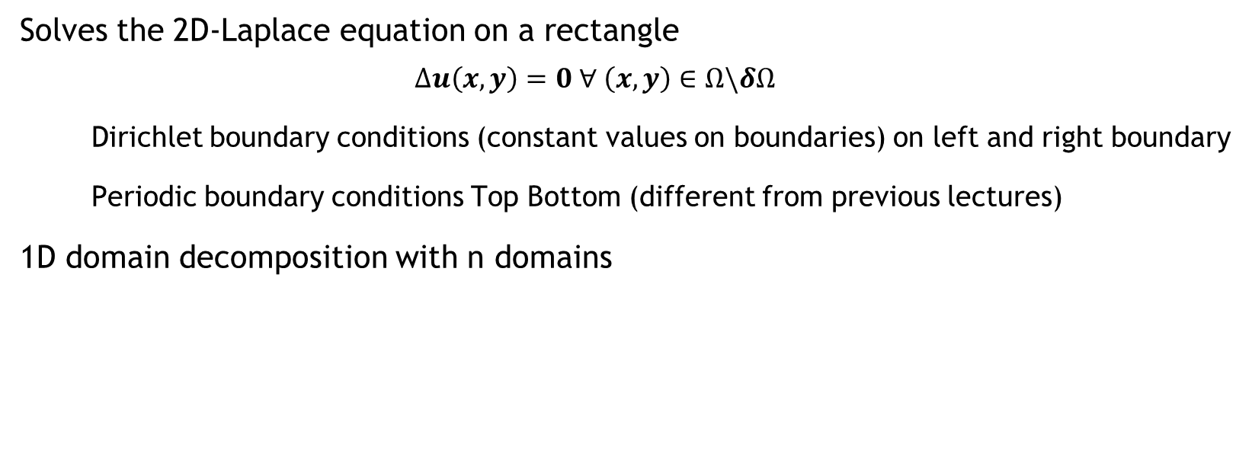
Example: Jacobi Solver
Solves the 2D-Laplace equation on a rectangle
$$∆u\left(x,y\right)=0 ∀ \left(x,y\right)∈Ω\backslash δΩ$$
Dirichlet boundary conditions (constant values on boundaries) on left and right boundary
Periodic boundary conditions Top Bottom (different from previous lectures)
1D domain decomposition with n domains
Rank 0
…
Rank n-1

Slide 44

Example: Jacobi Solver – Single GPU
While not converged
Do Jacobi step:
for (int j=1; j < n-1; j++)
for (int i=1; i < m-1; i++)
Anew[j][i] = 0.0f - 0.25f*(A[j-1][i] + A[j+1][i]
+A[j][i-1] + A[j][i+1])
Copy Anew to A
Apply periodic boundary conditions
(new compared to previous lectures)
Next iteration

Slide 45
Handling GPU Affinity
Rely on process placement (with one rank per GPU)*
int rank = 0;
MPI_Comm_rank(MPI_COMM_WORLD,&rank);
int ngpus = acc_get_num_devices(acc_device_nvidia); // ngpus == ranks per node
int devicenum = rank % ngpus;
acc_set_device_num(devicenum,acc_device_nvidia);
*This assumes the node is homogeneous, i.e. that all the GPUs are the same. If you have different GPUs in the same node then you may need some more complex GPU selection

Slide 46
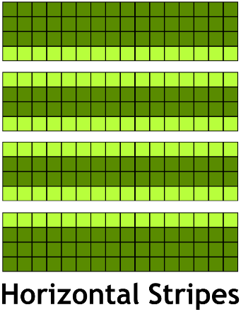
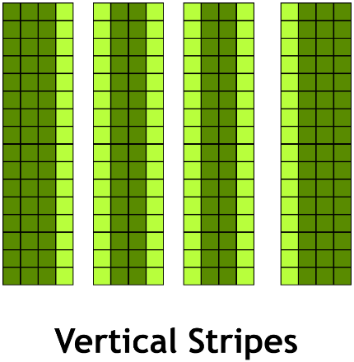
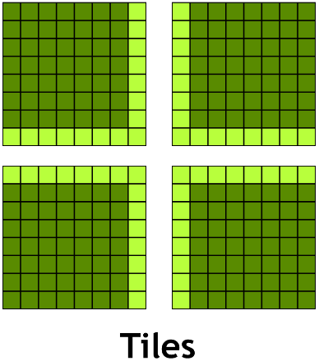
Domain Decomposition
Different Ways to split the work between processes:
Minimizes number of neighbors:
Communicate to less neighbors
Optimal for latency bound communication
Minimizes surface area/volume ratio:
Communicate less data
Optimal for bandwidth bound communication
Contiguous if data is row-major
Contiguous if data is column-major

Slide 47
Domain Decomposition
Different Ways to split the work between processes:
Minimizes number of neighbors:
Communicate to less neighbors
Optimal for latency bound communication
Minimizes surface area/volume ratio:
Communicate less data
Optimal for bandwidth bound communication
Contiguous if data is row-major
Contiguous if data is column-major

Slide 48
Example: Jacobi Solver – Multi GPU
While not converged
Do Jacobi step:
for (int j=jstart; j < jend; j++)
for (int i=1; i < m-1; i++)
Anew[j][i] = 0.0f - 0.25f*(A[j-1][i] + A[j+1][i]
+A[j][i-1] + A[j][i+1])
Copy Anew to A
Apply periodic boundary conditions
Exchange halo with 1 to 2 neighbors
Next iteration

Slide 49
Example: Jacobi Solver – Multi GPU
While not converged
Do Jacobi step:
for (int j=jstart; j < jend; j++)
for (int i=1; i < m-1; i++)
Anew[j][i] = 0.0f - 0.25f*(A[j-1][i] + A[j+1][i]
+A[j][i-1] + A[j][i+1])
Copy Anew to A
Apply periodic boundary conditions
Exchange halo with 1 to 2 neighbors
Next iteration
One-step with ring exchange

Slide 50
Example: Jacobi – Top/Bottom Halo

Slide 51
Example: Jacobi – Top/Bottom Halo
MPI_Sendrecv(A[jstart], M, MPI_FLOAT, top, 0,
A[jend], M, MPI_FLOAT, bottom, 0,
MPI_COMM_WORLD, MPI_STATUS_IGNORE);

Slide 52
Example: Jacobi – Top/Bottom Halo
MPI_Sendrecv(A[jstart], M, MPI_FLOAT, top, 0,
A[jend], M, MPI_FLOAT, bottom, 0,
MPI_COMM_WORLD, MPI_STATUS_IGNORE);

Slide 53
Example: Jacobi – Top/Bottom Halo
MPI_Sendrecv(A[jstart], M, MPI_FLOAT, top, 0,
A[jend], M, MPI_FLOAT, bottom, 0,
MPI_COMM_WORLD, MPI_STATUS_IGNORE);
1
1

Slide 54
Example: Jacobi – Top/Bottom Halo
MPI_Sendrecv(A[jstart], M, MPI_FLOAT, top, 0,
A[jend], M, MPI_FLOAT, bottom, 0,
MPI_COMM_WORLD, MPI_STATUS_IGNORE);
1
MPI_Sendrecv(A[(jend-1)], M, MPI_FLOAT, bottom, 0,
A[(jstart-1)], M, MPI_FLOAT, top, 0,
MPI_COMM_WORLD, MPI_STATUS_IGNORE);
1

Slide 55
Example: Jacobi – Top/Bottom Halo
MPI_Sendrecv(A[jstart], M, MPI_FLOAT, top, 0,
A[jend], M, MPI_FLOAT, bottom, 0,
MPI_COMM_WORLD, MPI_STATUS_IGNORE);
1
MPI_Sendrecv(A[(jend-1)], M, MPI_FLOAT, bottom, 0,
A[(jstart-1)], M, MPI_FLOAT, top, 0,
MPI_COMM_WORLD, MPI_STATUS_IGNORE);
1

Slide 56
Example: Jacobi – Top/Bottom Halo
MPI_Sendrecv(A[jstart], M, MPI_FLOAT, top, 0,
A[jend], M, MPI_FLOAT, bottom, 0,
MPI_COMM_WORLD, MPI_STATUS_IGNORE);
2
1
MPI_Sendrecv(A[(jend-1)], M, MPI_FLOAT, bottom, 0,
A[(jstart-1)], M, MPI_FLOAT, top, 0,
MPI_COMM_WORLD, MPI_STATUS_IGNORE);
2
1

Slide 57
OpenACC Interoperability

Slide 58

OpenACC Interoperability
OpenACC plays well with others.
Add CUDA or accelerated libraries to an OpenACC application
Add OpenACC to an existing accelerated application
Share data between OpenACC and CUDA

Slide 59
OpenACC host_data Directive
Exposes the device address of particular objects to the host code.
#pragma acc data copy(x,y)
{
// x and y are host pointers
#pragma acc host_data use_device(x,y)
{
// x and y are device pointers
}
// x and y are host pointers
}
X and Y are device pointers here

Slide 60
host_data Example
OpenACC Main
CUDA C Kernel & Wrapper
program main
integer, parameter :: N = 2**20
real, dimension(N) :: X, Y
real :: A = 2.0
!$acc data
! Initialize X and Y
...
!$acc host_data use_device(x,y)
call saxpy(n, a, x, y)
!$acc end host_data
!$acc end data
end program
__global__
void saxpy_kernel(int n, float a,
float *x, float *y)
{
int i = blockIdx.x*blockDim.x + threadIdx.x;
if (i < n) y[i] = a*x[i] + y[i];
}
void saxpy(int n, float a, float *dx, float *dy)
{
// Launch CUDA Kernel
saxpy_kernel<<<4096,256>>>(N, 2.0, dx, dy);
}
It’s possible to interoperate from C/C++ or Fortran.
OpenACC manages the data and passes device pointers to CUDA.
CUDA kernel launch wrapped in function expecting device arrays.
Kernel is launch with arrays passed from OpenACC in main.

Slide 61
CUBLAS Library & OpenACC
OpenACC Main Calling CUBLAS
OpenACC can interface with existing GPU-optimized libraries (from C/C++ or Fortran).
This includes…
CUBLAS
Libsci_acc
CUFFT
MAGMA
CULA
Thrust
…
int N = 1<<20;
float *x, *y
// Allocate & Initialize X & Y
...
cublasInit();
#pragma acc data copyin(x[0:N]) copy(y[0:N])
{
#pragma acc host_data use_device(x,y)
{
// Perform SAXPY on 1M elements
cublasSaxpy(N, 2.0, x, 1, y, 1);
}
}
cublasShutdown();

Slide 62
Example: Jacobi – Top/Bottom Halo
#pragma acc host_data use_device ( A ) {
MPI_Sendrecv(A[jstart], M, MPI_FLOAT, top, 0,
A[jend], M, MPI_FLOAT, bottom, 0,
MPI_COMM_WORLD, MPI_STATUS_IGNORE);
2
1
MPI_Sendrecv(A[(jend-1)], M, MPI_FLOAT, bottom, 0,
A[(jstart-1)], M, MPI_FLOAT, top, 0,
MPI_COMM_WORLD, MPI_STATUS_IGNORE);
}
2
1

Slide 63
Example: Jacobi – Top/Bottom Halo
!$acc host_data use_device( A )
CALL MPI_Sendrecv(a(1,jstart), n, MPI_REAL, top, 0,
a(1,jend+1), n, MPI_REAL, bottom, 0,
MPI_COMM_WORLD, MPI_STATUS_IGNORE, ierror)
2
1
CALL MPI_Sendrecv(a(1,jend), n, MPI_REAL, bottom, 0,
a(1,jstart-1), n, MPI_REAL, top, 0,
MPI_COMM_WORLD, MPI_STATUS_IGNORE, ierror)
!$acc end host_data
2
1

Slide 64
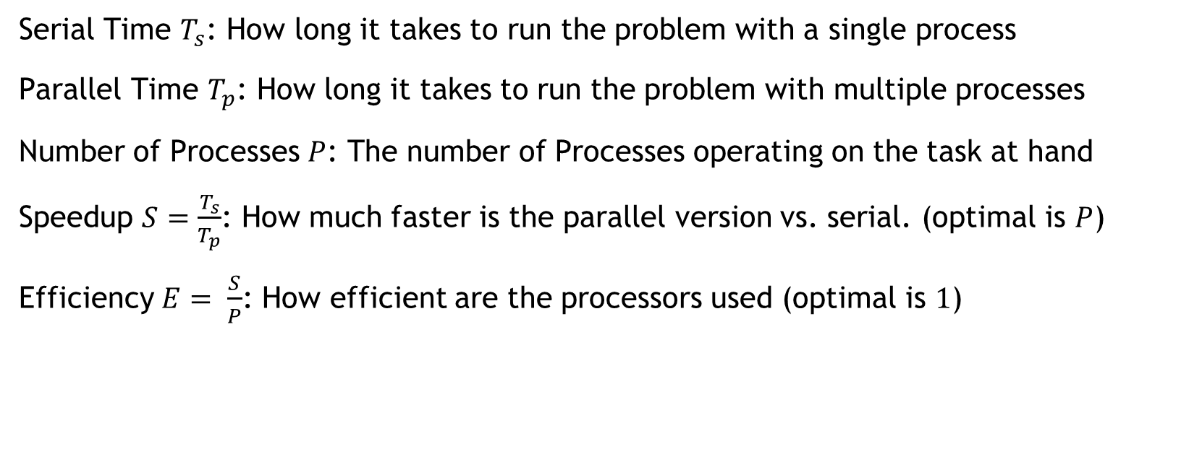
Scalability Metrics For Success
Serial Time $T_{s}$: How long it takes to run the problem with a single process
Parallel Time $T_{p}$: How long it takes to run the problem with multiple processes
Number of Processes $P$: The number of Processes operating on the task at hand
Speedup $S=\frac{T_{s}}{T_{p}}$: How much faster is the parallel version vs. serial. (optimal is $P$)
Efficiency $E= \frac{S}{P}$: How efficient are the processors used (optimal is $1$)

Slide 65
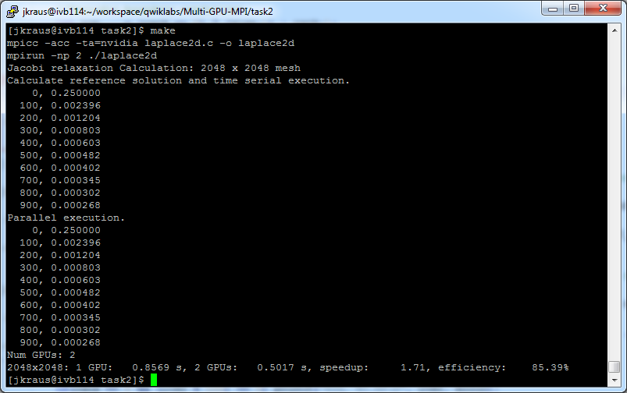
Step 2: Results

Slide 66
Profiling MPI+OPENACC applications
Using nvprof+NVVP:
Embed MPI Rank in output filename to be read by NVVP
mpirun –np 2 nvprof --output-profile profile.%q{OMPI_COMM_WORLD_RANK}.out …
Using nvprof only:
Only save the textual output
mpirun –np 2 nvprof --log-file profile .%q{OMPI_COMM_WORLD_RANK}.log

Slide 67
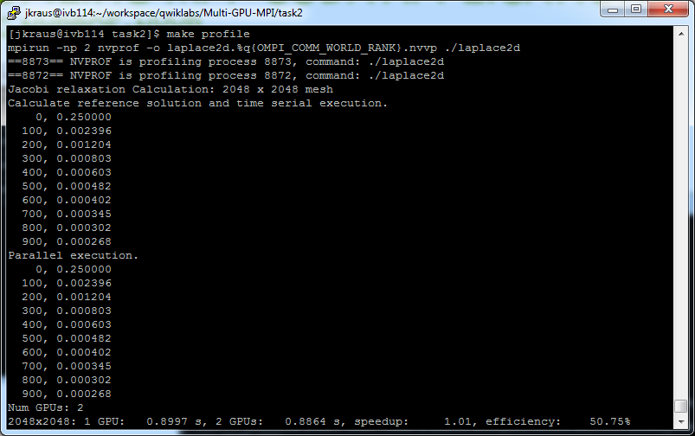
Profiling MPI+OPENACC applications

Slide 68
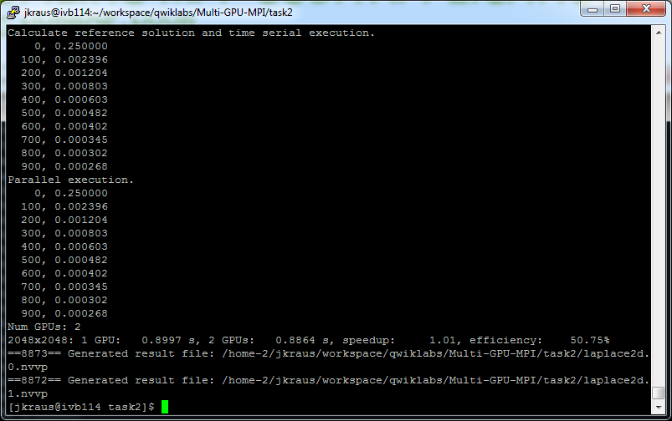
Profiling MPI+OPENACC applications

Slide 69
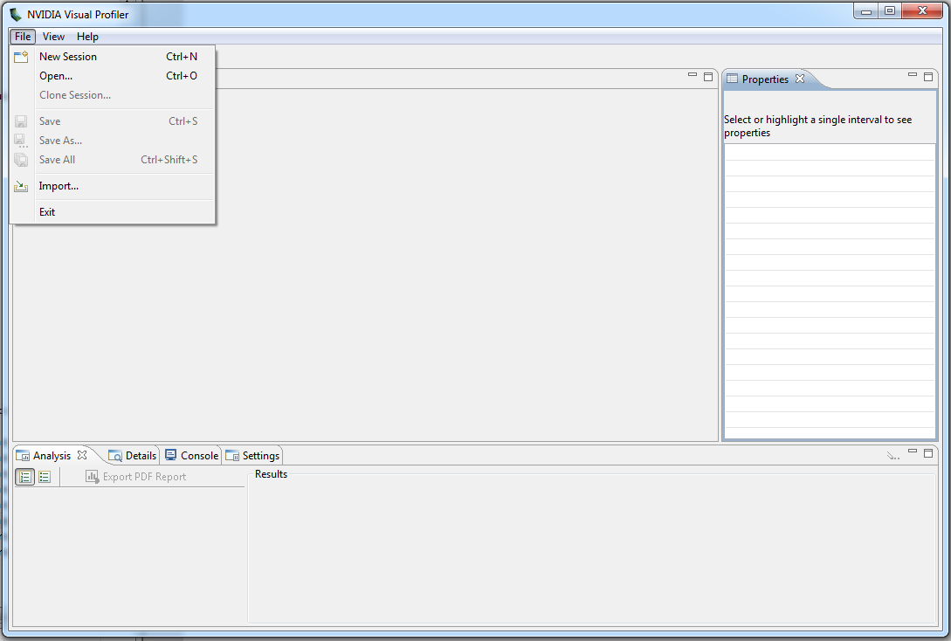
Profiling MPI+OPENACC applications

Slide 70
Profiling MPI+OPENACC applications

Slide 71
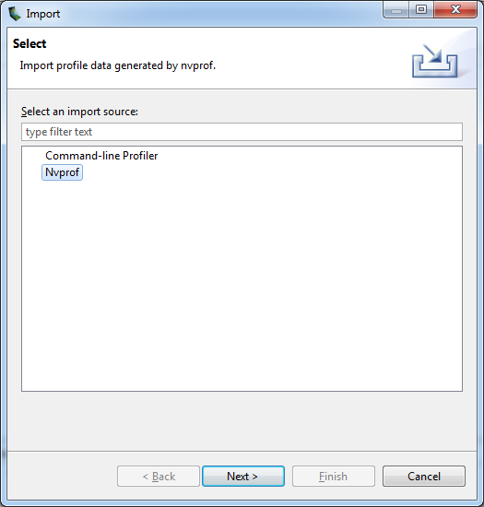
Profiling MPI+OPENACC applications

Slide 72
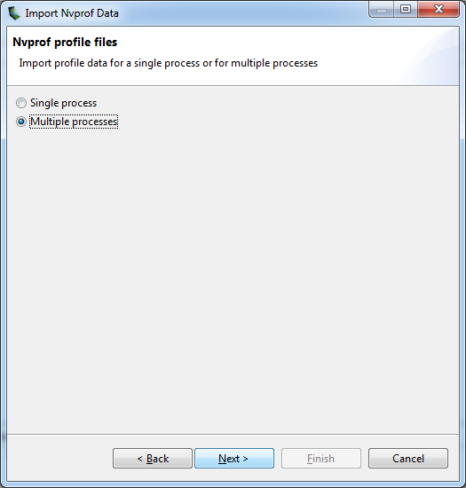
Profiling MPI+OPENACC applications

Slide 73
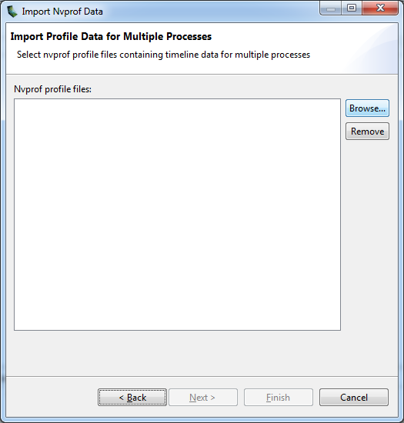
Profiling MPI+OPENACC applications

Slide 74
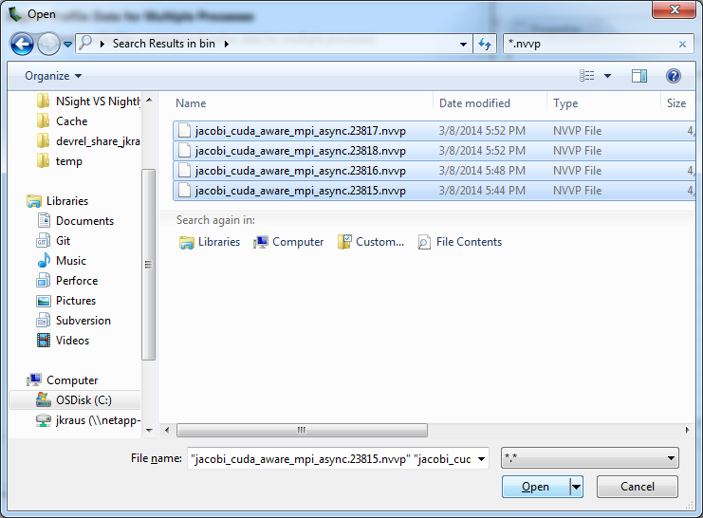
Profiling MPI+OPENACC applications

Slide 75
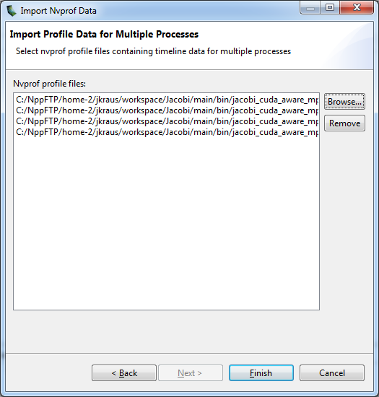
Profiling MPI+OPENACC applications

Slide 76
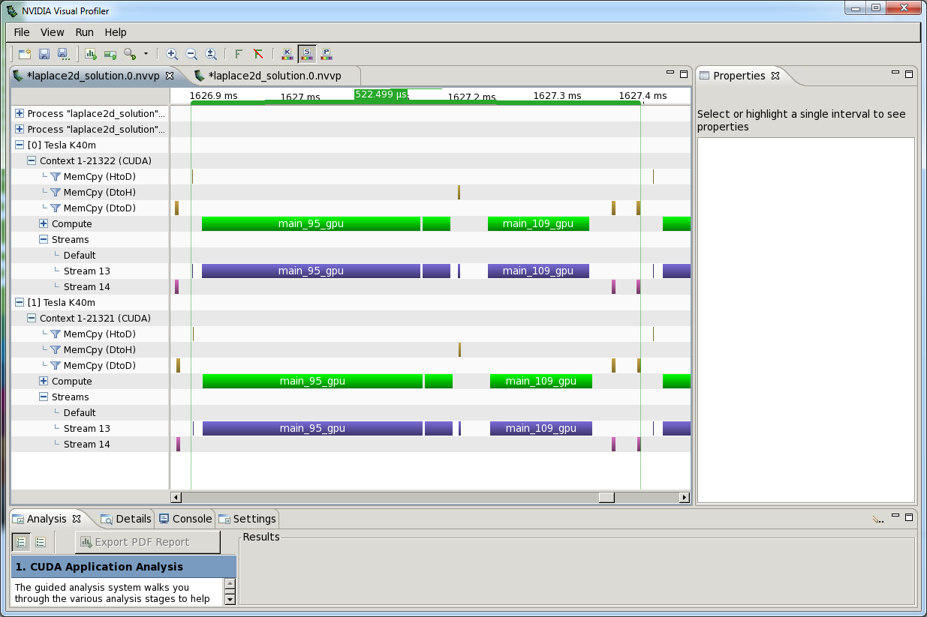
Profiling MPI+OPENACC applications

Slide 77
Communication + Computation Overlap
No Overlapp
Process whole domain
MPI
Ideal
Process whole domain
Possible Speedup

Slide 78
Communication + Computation Overlap

Slide 79
Communication + Computation Overlap
No Overlapp
Process whole domain
MPI
Boundary and inner domain processing can overlapp
Overlapp
Process inner domain
Possible Speedup
Process boundary domain
MPI
Dependency

Slide 80
Communication + Computation Overlap
#pragma acc kernels
for ( ... )
//Process boundary
#pragma acc kernels async
for ( ... )
//Process inner domain
#pragma acc host_data use_device ( A )
{
//Exchange halo with top and bottom neighbor
MPI_Sendrecv( A…);
//…
}
//wait for iteration to finish
#pragma acc wait

Slide 81
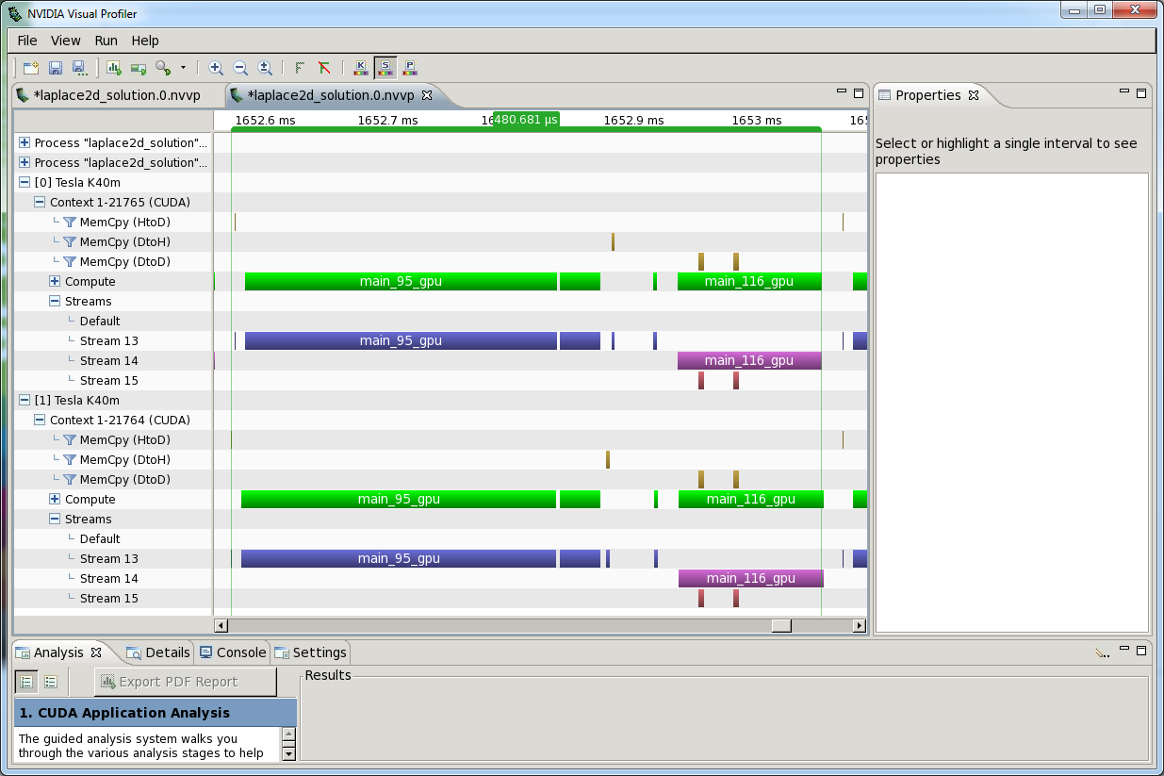
Profiling MPI+OPENACC Applications

Slide 82
Communication + Computation Overlap

Slide 83
Multi GPU Jacobi Solver
Homework
The Homework for this case study is available in the “Introduction to Multi GPU Programming with MPI and OpenACC“ lab at https://nvidia.qwiklab.com/ and consists of 3 tasks
Add MPI boiler plate code: Use MPI compiler wrapper, Intialize MPI, …
Distribute work across GPUs
Overlap communication and computation to improve multi GPU scalability.

Slide 84
Homework

Slide 85
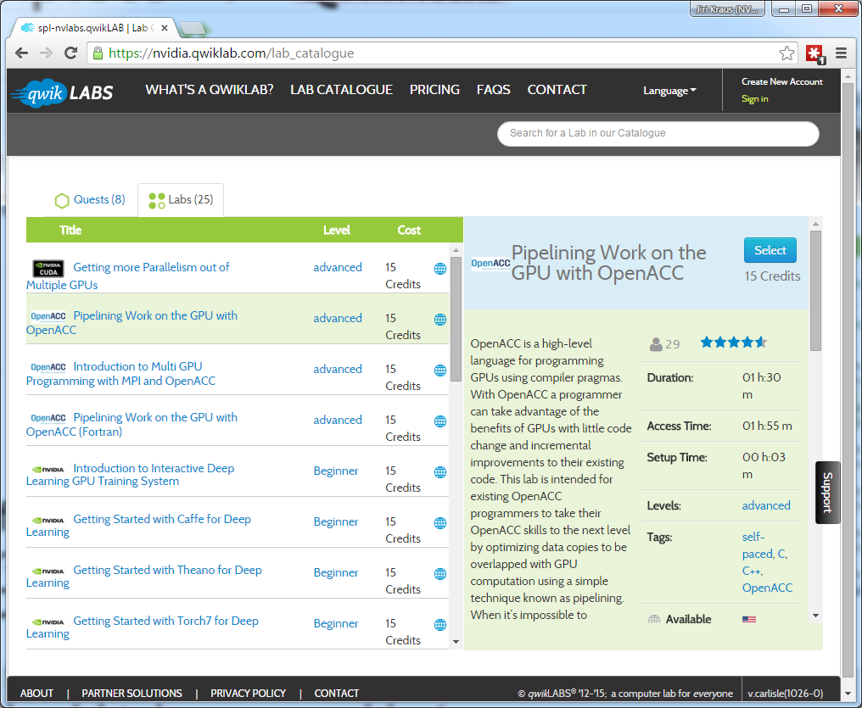
Complete Pipelining and MPI Qwiklab
From the NVIDIA Qwiklab website, select the Home Work
Pipelining Work on the GPU with OpenACC (~1.5 hours)
bit.ly/nvoacclab4
Introduction to Multi GPU Programming with MPI and OpenACC (~1.5 hours)
bit.ly/nvoacclab4b

Slide 86
Where to find help
OpenACC Course Recordings - https://developer.nvidia.com/openacc-course
OpenACC Toolkit - http://developer.nvidia.com/openacc
Parallel Forall Blog - http://devblogs.nvidia.com/parallelforall/
Hands-on Training - http://nvidia.qwiklabs.com
GPU Technology Conference - http://www.gputechconf.com/
NVIDIA DevTalk Forums - https://devtalk.nvidia.com/default/board/56
OpenACC on StackOverflow - http://stackoverflow.com/questions/tagged/openacc
OpenACC - http://openacc.org/

Slide 87
Office Hours In Two Week
Last session in two weeks will be an office hours session.
Bring your questions from this week’s lecture and homework to that session.
If you can’t wait until then, post a question on StackOverflow tagged with openacc.

Slide 88
Oct 1: Introduction to OpenACC
Oct 6: Office Hours
Oct 15: Profiling and Parallelizing with the OpenACC Toolkit
Oct 20: Office Hours
Oct 29: Expressing Data Locality and Optimizations with OpenACC
Nov 3: Office Hours
Nov 12: Advanced OpenACC Techniques
Nov 24: Office Hours
Course Syllabus
Recordings: https://developer.nvidia.com/openacc-course

Slide 89
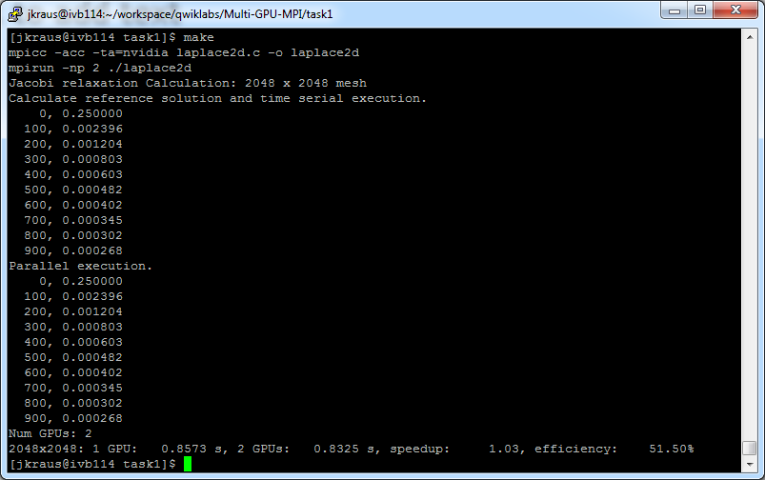
Step 1: Results

Slide 90
OpenACC & CUDA Streams
OpenACC suggests two functions for interoperating with CUDA streams:
void* acc_get_cuda_stream( int async );
int acc_set_cuda_stream( int async, void* stream );

Slide 91
OpenACC deviceptr
The deviceptr clause informs the compiler that an object is already on the device, so no translation is necessary.
Valid for parallel, kernels, and data
cudaMallocManaged((void*)&x,(size_t)n*sizeof(float));
cudaMallocManaged((void*)&y,(size_t)n*sizeof(float));
#pragma acc parallel loop deviceptr(x,y)
for(int i=0; i<n ; i++)
{
y(i) = a*x(i)+y(i)
}
Do not translate x and y, they are already on the device.
Notes:
Might be worth pointing out: I use MallocManaged because if the program uses too much memory to use –ta=tesla:managed, you can still use managed on some arrays using this trick.

Slide 92
deviceptr Example
OpenACC Kernels
CUDA C Main
void saxpy(int n, float a, float * restrict x, float * restrict y)
{
#pragma acc kernels deviceptr(x[0:n],y[0:n])
{
for(int i=0; i<n; i++)
{
y[i] += 2.0*x[i];
}
}
}
int main(int argc, char **argv)
{
float *x, *y, tmp;
int n = 1<<20, i;
cudaMalloc((void*)&x,(size_t)n*sizeof(float));
cudaMalloc((void*)&y,(size_t)n*sizeof(float));
...
saxpy(n, 2.0, x, y);
cudaMemcpy(&tmp,y,(size_t)sizeof(float),
cudaMemcpyDeviceToHost);
return 0;
}
By passing a device pointer to an OpenACC region, it’s possible to add OpenACC to an existing CUDA code.
Memory is managed via standard CUDA calls.

Slide 93
OpenACC & Thrust
Thrust (thrust.github.io) is a STL-like library for C++ on accelerators.
High-level interface
Host/Device container classes
Common parallel algorithms
It’s possible to cast Thrust vectors to device pointers for use with OpenACC
int N = 1<<20;
thrust::host_vector<float> x(N), y(N);
for(int i=0; i<N; i++)
{
x[i] = 1.0f;
y[i] = 0.0f;
}
// Copy to Device
thrust::device_vector<float> d_x = x;
thrust::device_vector<float> d_y = y;
saxpy(N,2.0, d_x.data().get(),
d_y.data().get());
// Copy back to host
y = d_y;
void saxpy(int n, float a, float * restrict x, float * restrict y)
{
#pragma acc kernels deviceptr(x[0:n],y[0:n])
{
for(int i=0; i<n; i++)
{
y[i] += 2.0*x[i];
}
}
}

Slide 94
CUDA Device Routines and OpenACC
extern “C” __device__ void
f1dev( float* a, float* b, int i ){
a[i] = .... b[i] .... ;
}
#pragma acc routine seq
extern “C” void f1dev( float*, float* int );
...
#pragma acc parallel loop \
present( a[0:n], b[0:n] )
for( int i = 0; i < n; ++i )
{
f1dev( a, b, i );
}
Even CUDA __device__ functions can be called from OpenACC if declared with acc routine.

Slide 95
OpenACC acc_map_data function
The acc_map_data (acc_unmap_data) maps (unmaps) an existing device allocation to an OpenACC variable.
cudaMalloc((void*)&x_d,(size_t)n*sizeof(float));
acc_map_data(x, x_d, n*sizeof(float));
cudaMalloc((void*)&y_d,(size_t)n*sizeof(float));
acc_map_data(y, y_d, n*sizeof(float));
#pragma acc parallel loop
for(int i=0; i<n ; i++)
{
y(i) = a*x(i)+y(i)
}
Allocate device arrays with CUDA and map to OpenACC
Here x and y will reuse the memory of x_d and y_d

Slide 96
Using QwikLabs

Slide 97
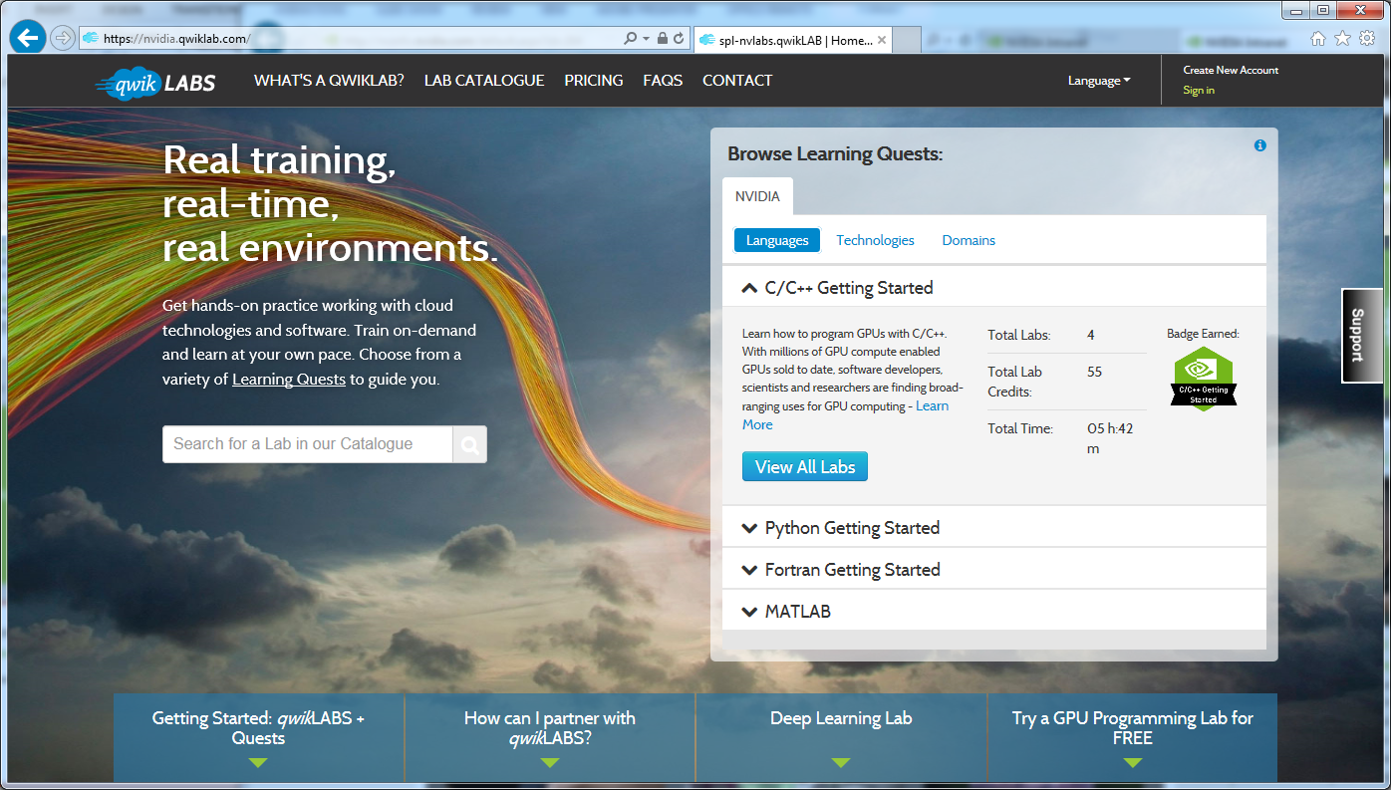
Getting access
Sign In or Create a New Account
Go to nvidia.qwiklab.com, log-in or create an account

